Slide 1
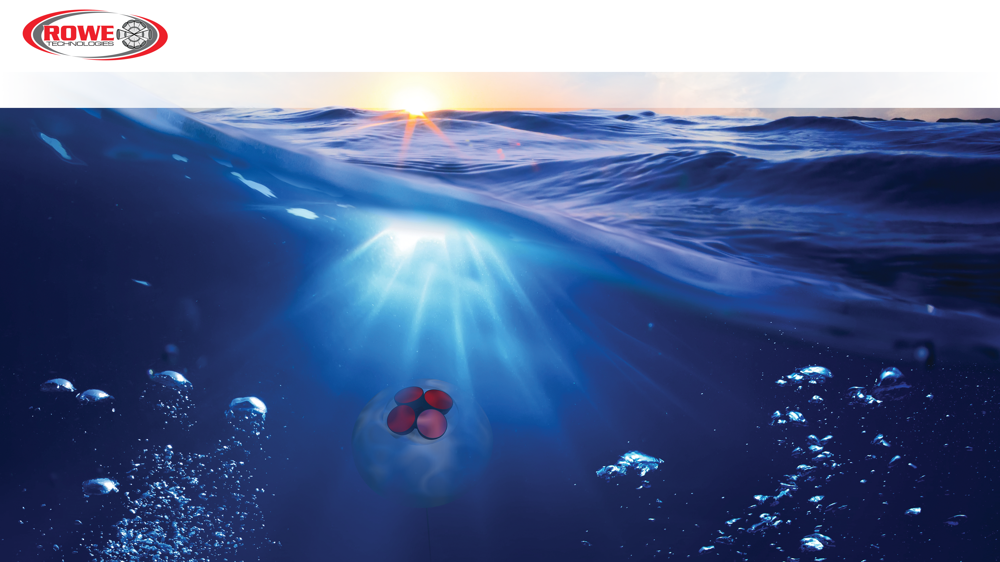
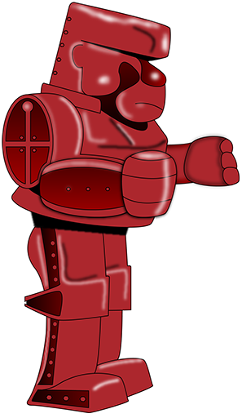
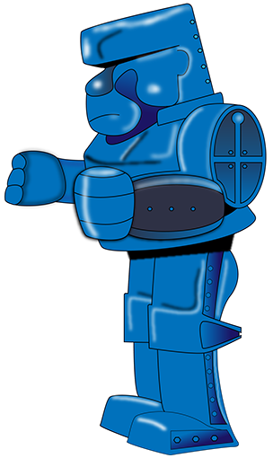
Rowe Technologies, Inc.
Doppler Pinging The World’s Waters
Rowe Technologies 300 kHz SeaWATCH,
Rowe Technologies Long Range 300 kHz SeaWATCH,
and Teledyne 300 kHz Sentinel data comparison
Tech Note 002
sales@rowetechinc.com
www.rowetechinc.com
This presentation contains CONFIDENTIAL INFORMATION proprietary to RoweTech. By reviewing the content of this presentation, you agree to keep the information presented herein confidential and to not use any CONFIDENTIAL INFORMATION for any purpose except to evaluate and engage in discussions concerning a potential business relationship with RoweTech.
1

Slide 2
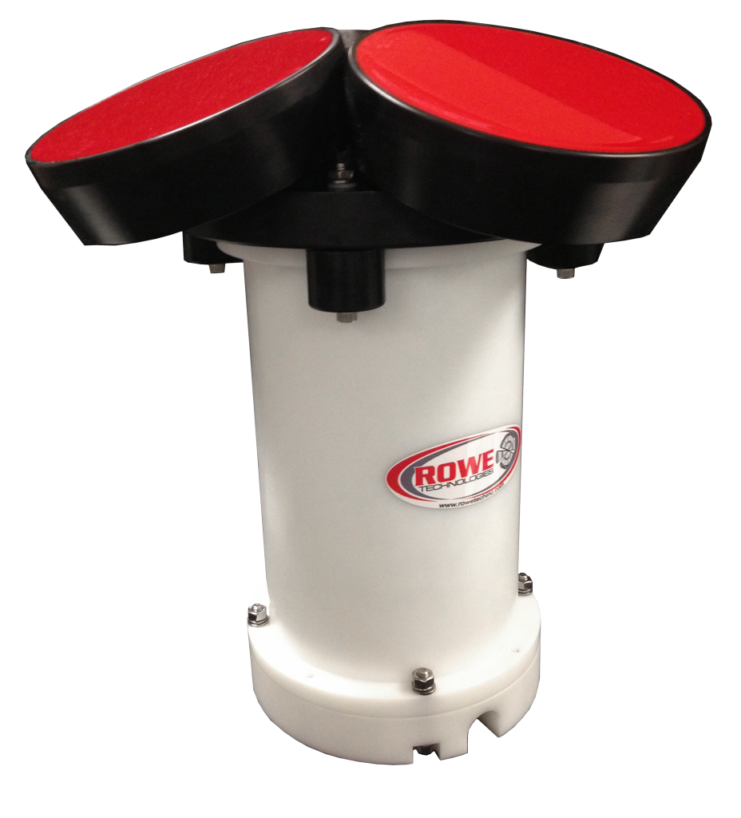
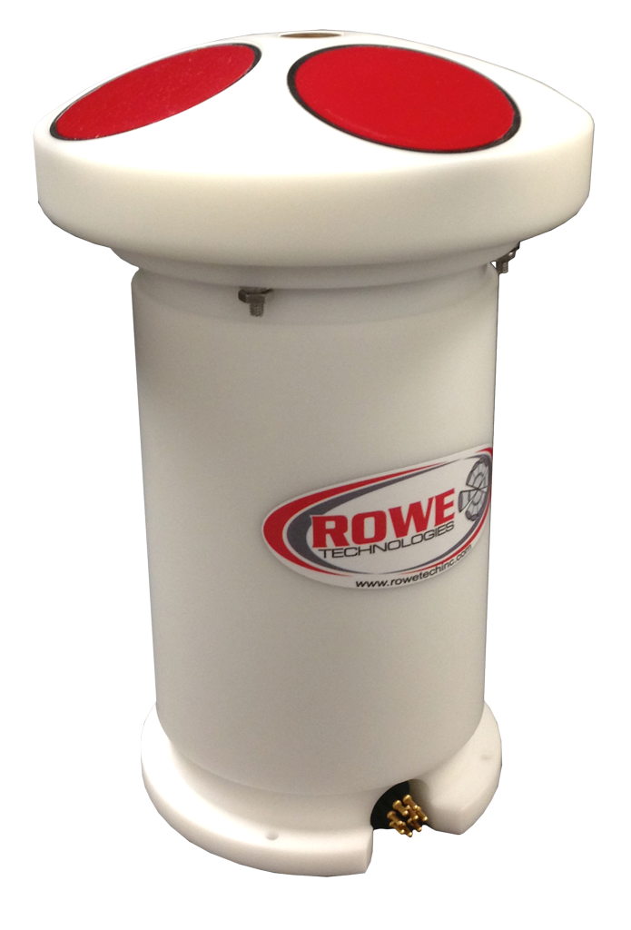
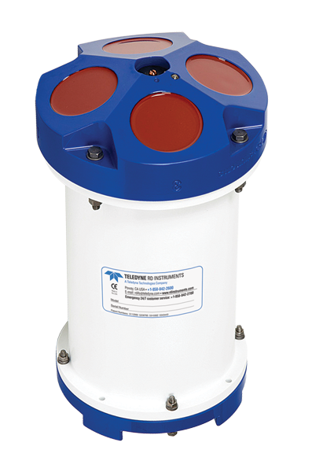
Rowe Technologies, Inc.
SeaWATCH 300 kHz To Teledyne Sentinel 300 kHz Comparison
Goals
Compare the performance of a Rowe Tech SeaWATCH 300 kHz to the Teledyne Sentinel 300 kHz in shallow and deep water.
Demonstrate increased range of Rowe Tech long range 300 kHz SeaWATCH compared to standard 300 kHz ADCP’s in deep water.
Systems
SeaWATCH 300
Sentinel 300
SeaWATCH 300 5”

Slide 3
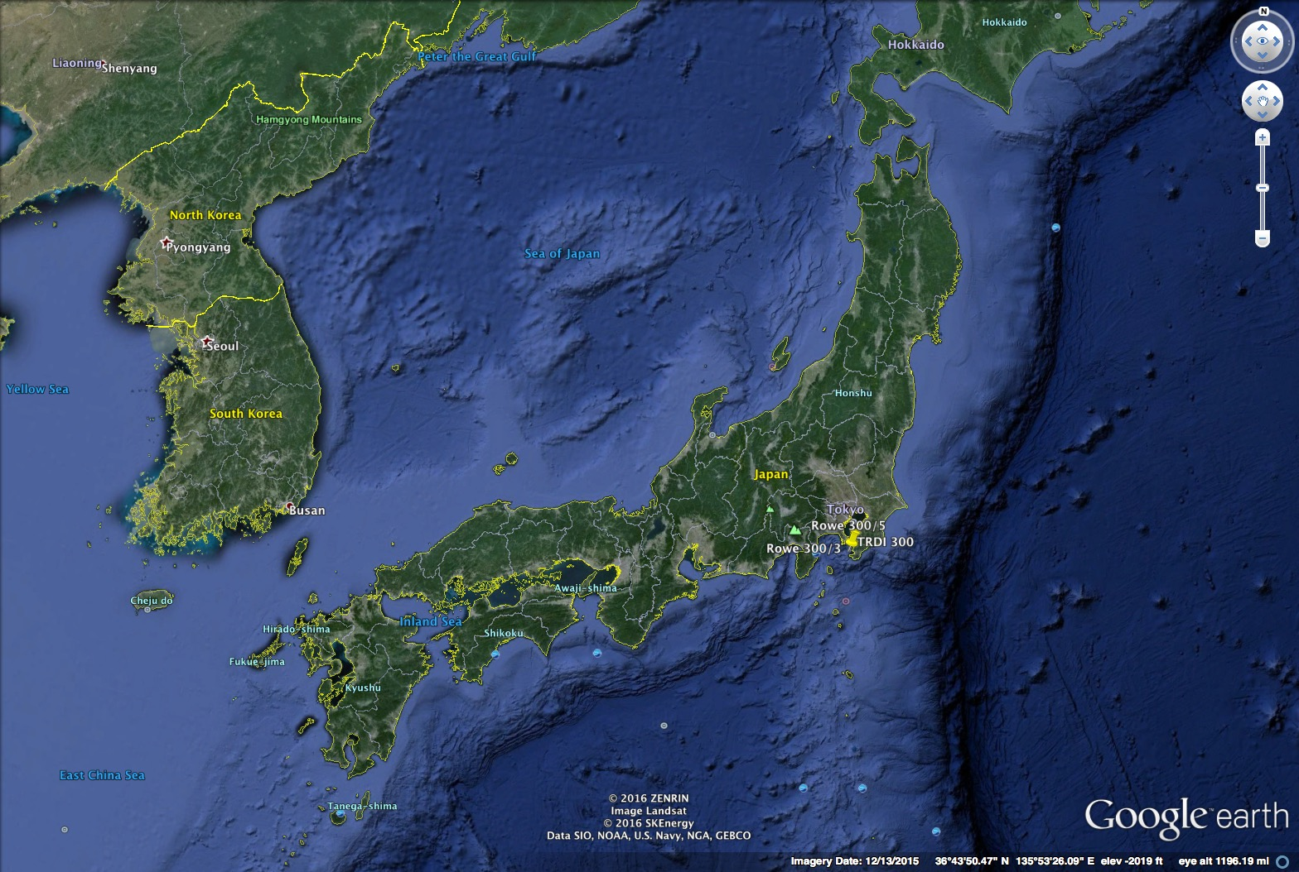
Rowe Technologies, Inc.
Deep water location: Japan, Tateyama Bay
SeaWATCH 5” 300
N35° 12' 27.4”
E139° 27' 29.3”
Depth: 200 m
SeaWATCH 3” 300
N35° 12' 20.5”
E139° 27' 43.5”
Depth: 175 m
Sentinel 300
N35° 10' 46.6”
E139° 27' 25.9”
Depth 175 m
1 km
Tateyama Bay
Deployment dates: 2016.8.1 – 2016.15.1
Deployed by: SEA Corporation Chiba Prefecture Tokyo Japan

Slide 4
Rowe Technologies, Inc.
Shallow water location: Busan, South Korea
Separation: 6 meters
New Busan port
Deployment dates: 2016.22.2 – 2016.27.2
Deployed by: Oceantech, Gyeonggi-do South Korea
SeaWATCH 300
N35° 15' 32.4"”
128° 27' 27.7"
TRBM Depth: 18 m
Sentinel 300
35° 15' 33.1"
E 128° 27' 27.8"
TRBM Depth 18 m

Slide 5
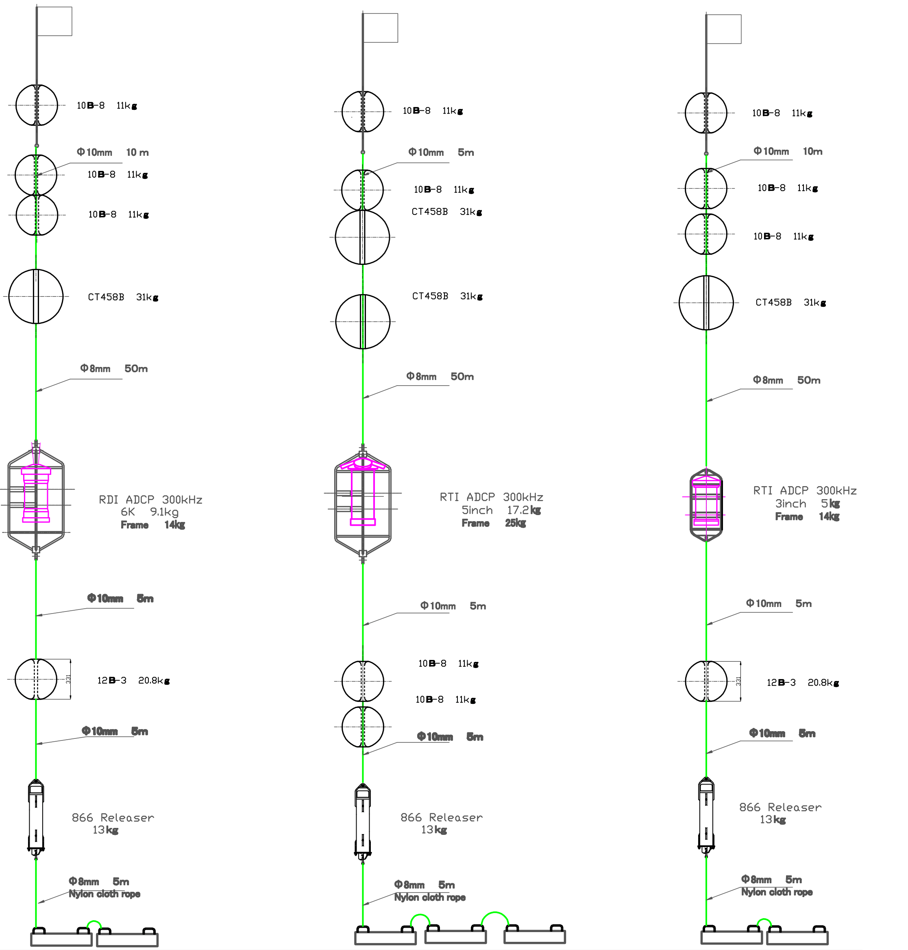
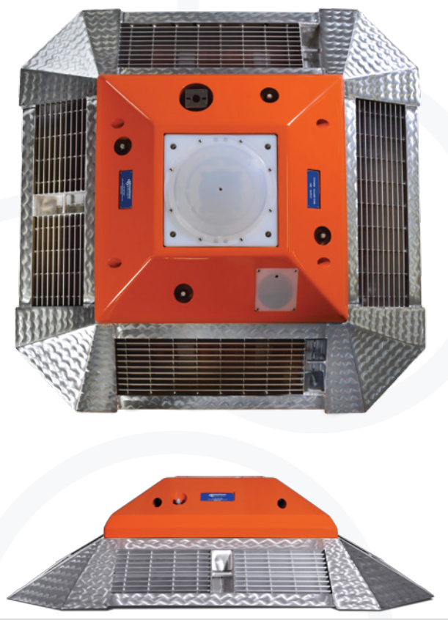
Rowe Technologies, Inc.
Mooring Schematic
Sentinel 300
SeaWATCH 300 5”
SeaWATCH 300
Typical Trawl Resistant Bottom Mount (TRBM)
Photo courtesy Deep Ocean Buoyancy
Deep Water
Shallow Water

Slide 6
Rowe Technologies, Inc.
Deep Water SYSTEM SETTINGS
Parameter | Teledyne 300 | Rowe Tech 3” | Rowe Tech 5”
System Frequency | 307.2 kHz | 311.3 kHz | 311.3 kHz
Firmware Version | 50.40 | 0.2.81 - 4 | 0.2.81 – 4
Beam Angle | 20 Degrees | 20 Degrees | 20 Degrees
False Target(WA) | 50 counts | n/a | n/a
Bandwidth (WB) | 25% | 8.33% | 8.33%
Cor. Threshold (WC) | 64 counts | 50 counts | 50 counts
Blank (WF) | 1.76 m | 1.6 m | 1.6 m
Mode (WM) | 1 | 1 | 1
Pings/Ens (WP) | 60 | 60 | 60
Bin Size (WS) | 4.00 m | 4.00 m | 4.00 m
Time/Ping (TP) | 00:01.00 | 00:01.00 | 00:01.00
Hardware | 4 Beams | 4 Beams | 4 Beams
Lag | 53 elements | 28 elements | 28 elements
Code Reps. | 9 | 5 | 5
Lag Length | 0.48 m | 0.98 | 0.98
Xmt Length | 4.28 m | 4.9 m | 4.9 m
1st Bin | 6.14 m | 6.05 m | 6.05 m
Orientation | UP | UP | UP
All systems were programmed identically
Ping times were offset to prevent interference.
6 minute ensembles, 60 pings, 1Hz ping rate.
Four meter bins.
3” systems deployed on common depth gradient line.
Deployed 25 meters off the bottom.
Default screening thresholds were used.

Slide 7
Rowe Technologies, Inc.
Shallow Water SYSTEM SETTINGS
Parameter | Teledyne Sentinel 300 | Rowe Tech SeaWATCH 300
System Frequency | 307.2 kHz | 288.3 kHz
Firmware Version | 50.40 | 0.2.81 - 4
Beam Angle | 20 Degrees | 20 Degrees
False Target(WA) | 50 counts | n/a
Bandwidth (WB) | 25% | 8.33%
Cor. Thres. (WC) | 64 counts | 50 counts
Blank (WF) | 1.76 m | 1.6 m
Mode (WM) | 1 | 1
Pings/Ens (WP) | 60 | 60
Bin Size (WS) | 1.00 m | 1.00 m
Time/Ping (TP) | 00:01.00 | 00:01.00
Hardware | 4 Beams | 4 Beams
Lag | 53 elements | 28 elements
Code Reps. | 7 | 5
Lag Length | 0.16 m | 0.24
Xmt Length | 1.12 m | 1.2 m
1st Bin | 3.21 | 3.04 m
Orientation | UP | UP
Both systems were programmed identically
Ping times were offset to prevent interference.
10 minute ensembles, 60 pings, 1Hz ping rate.
One meter bins.
Both systems deployed on common depth gradient line.
Deployed in a trawl resistant bottom mount.
Default screening thresholds were used.

Slide 8
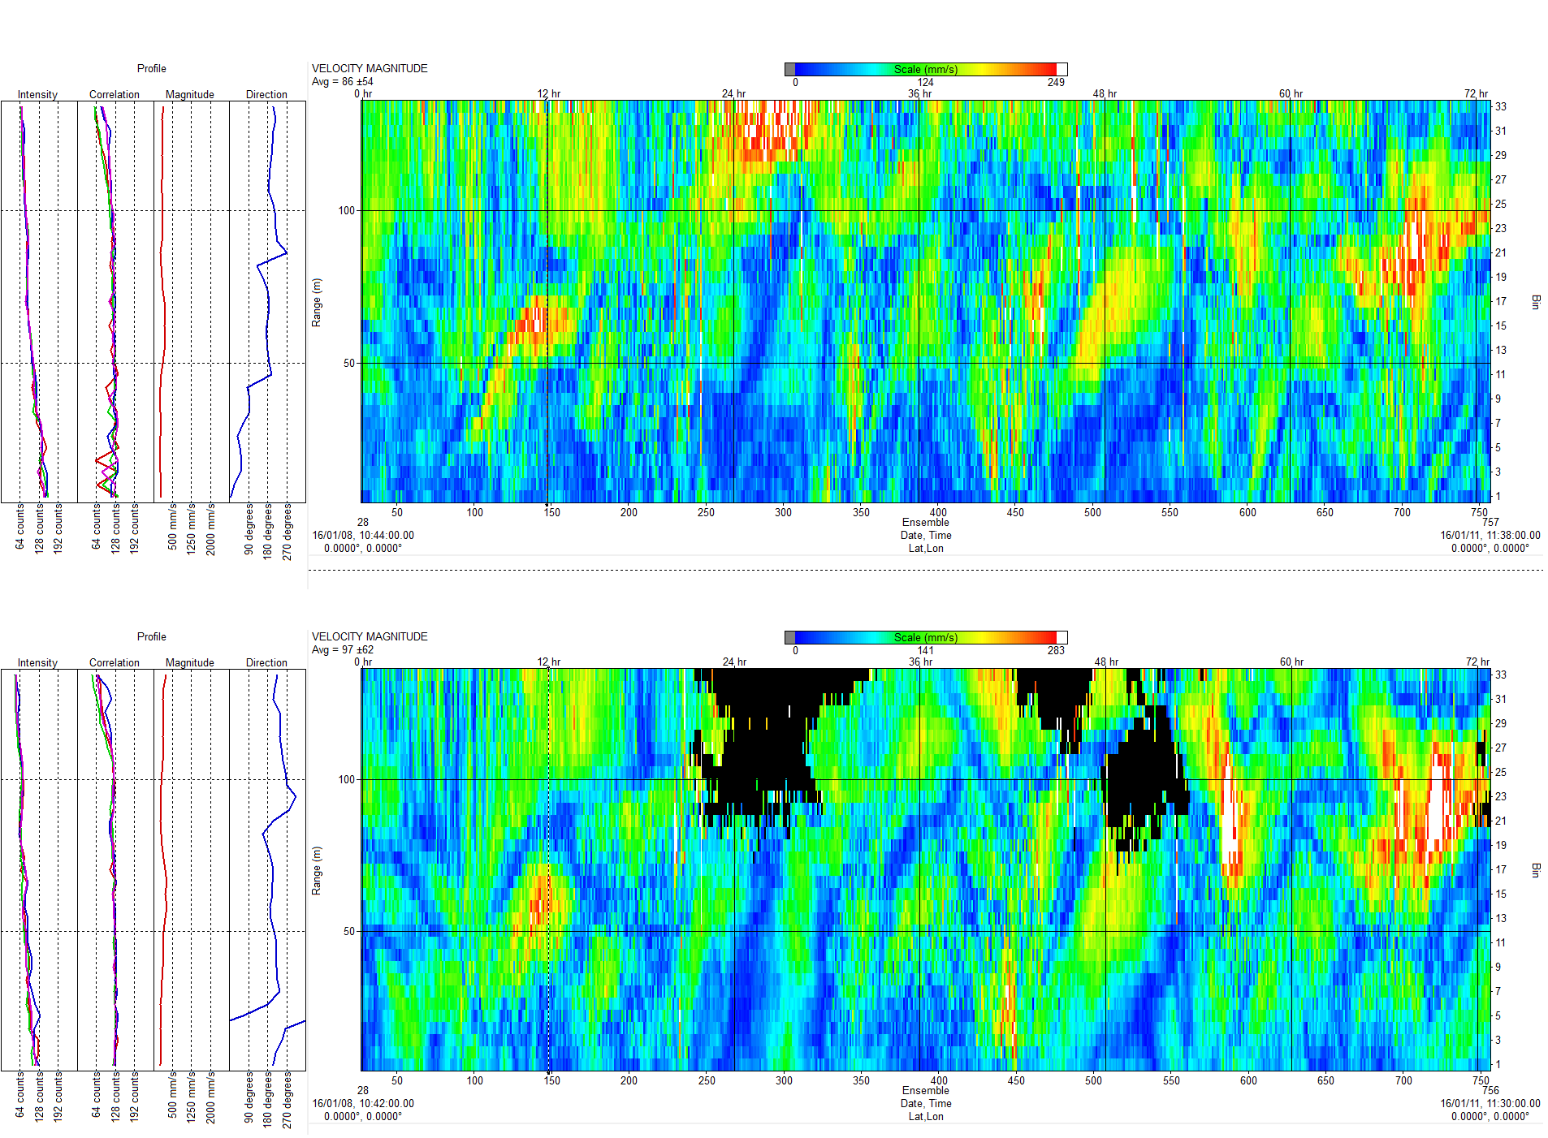
Rowe Technologies, Inc.
Deep Water Magnitude
Velocity Magnitude
SeaWATCH 300
Velocity magnitude of each system shows same magnitude structure, spatially and temporally.
The Sentinel system suffered from low echo intensity causing decorrelation of the data.
Sentinel 300

Slide 9
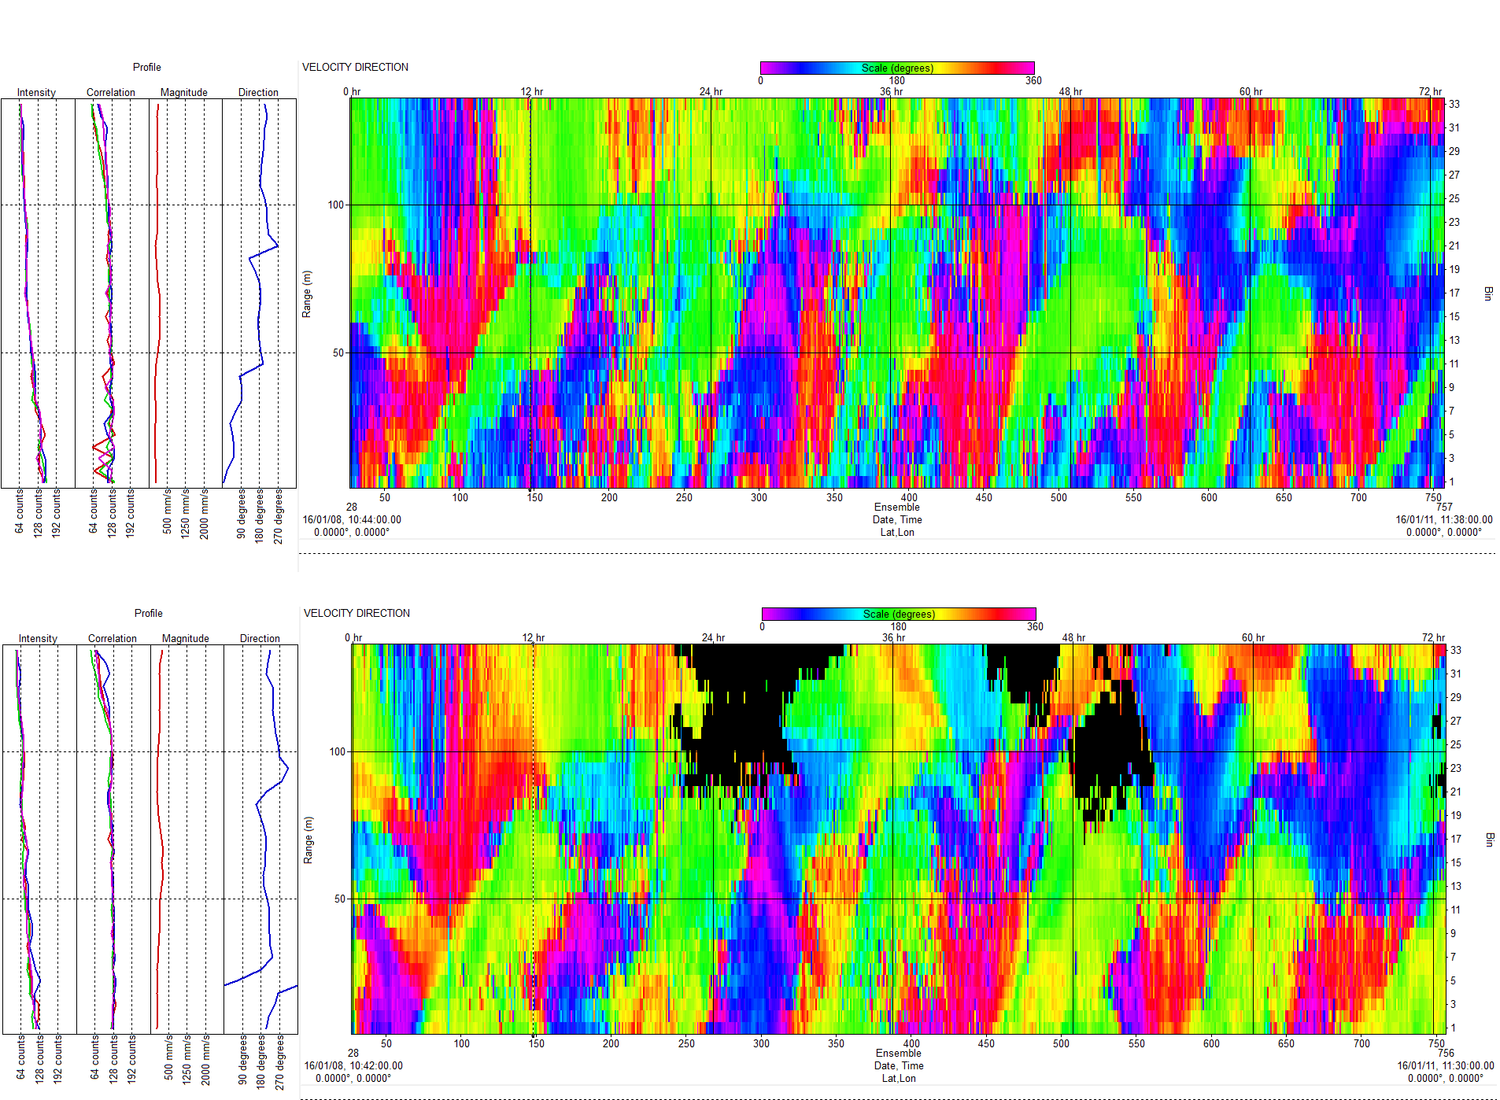
Rowe Technologies, Inc.
Deep Water Direction
Direction
SeaWATCH 300
Direction contours of each system shows same direction structure, spatially and temporally.
Both systems measure the direction changes of the semidiurnal tides exhibited in this region.
Sentinel 300

Slide 10
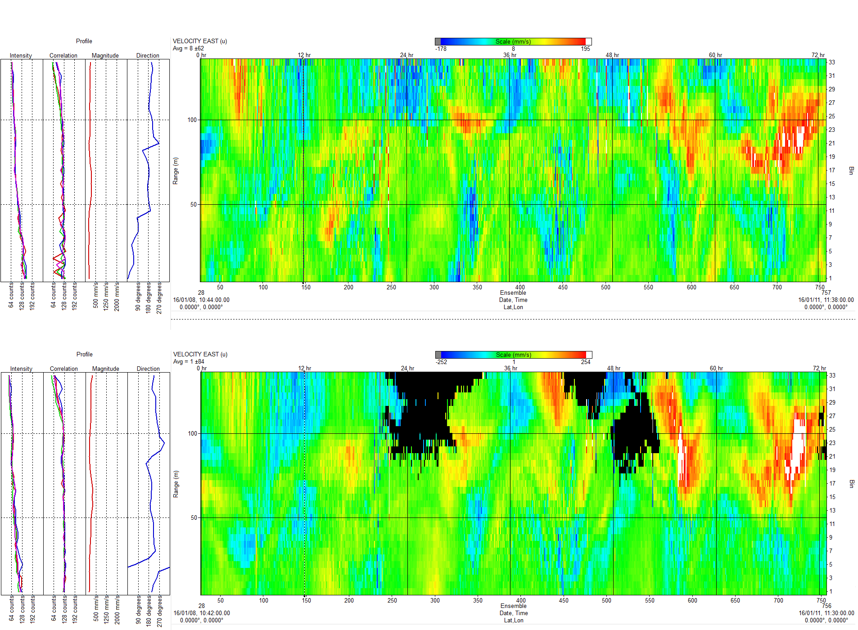
Rowe Technologies, Inc.
Deep Water East Velocity
East Velocity
SeaWATCH 300
East Velocity vector contour of each system shows same velocity structure, spatially and temporally.
Sentinel 300

Slide 11
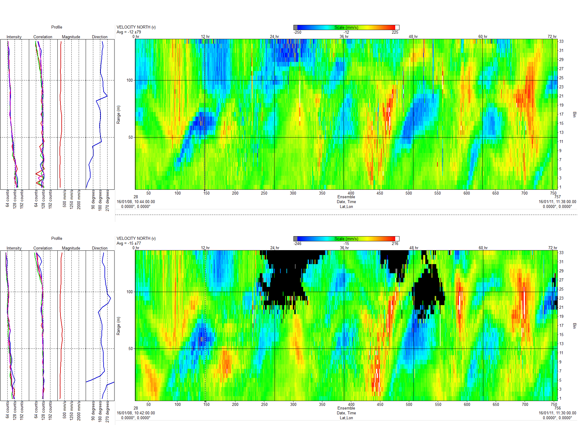
Rowe Technologies, Inc.
Deep Water North Velocity
North Velocity
SeaWATCH 300
North Velocity vector contour of each system shows same velocity structure, spatially and temporally.
Both systems show the main component of the tides are in the Northerly direction.
Sentinel 300

Slide 12
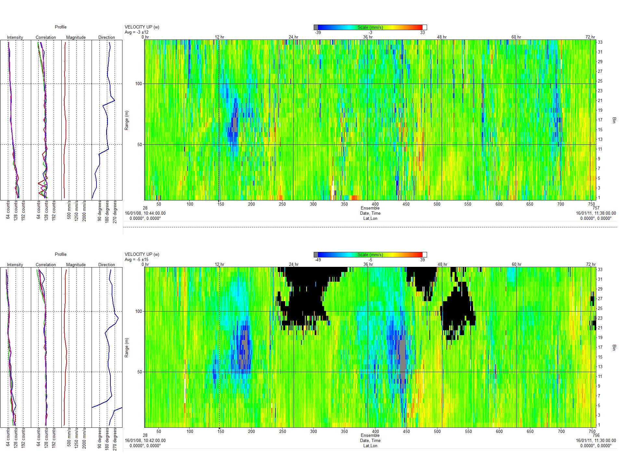
Rowe Technologies, Inc.
Deep Water Vertical Velocity
Vertical Velocity
SeaWATCH 300
Vertical Velocity vector contour of each system shows same velocity structure spatially and temporally.
Both systems show the same structure of the upwelling and down-welling.
Sentinel 300

Slide 13
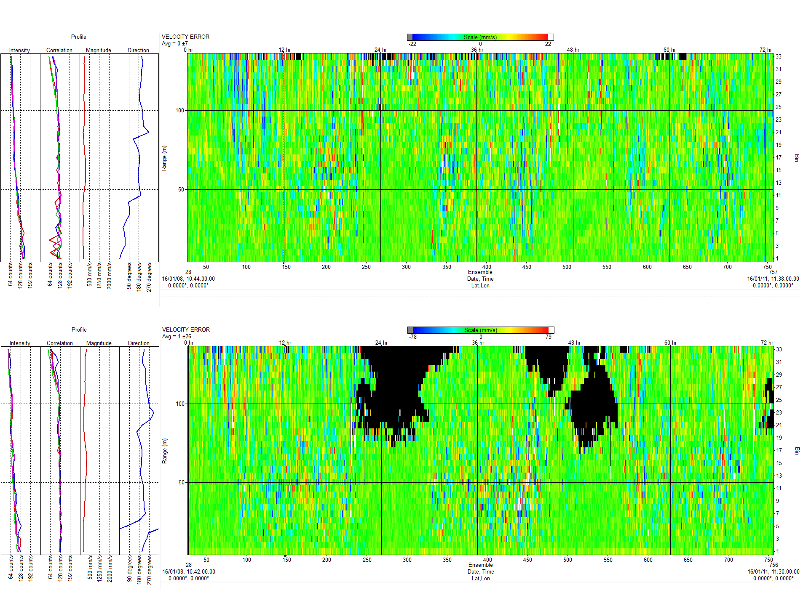
Rowe Technologies, Inc.
Deep Water Error Velocity
Error Velocity
SeaWATCH 300
Error Velocity contour plot of each system shows same indications of homogenous flows, typical of ocean deployments. Centered on zero with equal distribution of the highs/lows (red/blue).
Sentinel 300

Slide 14
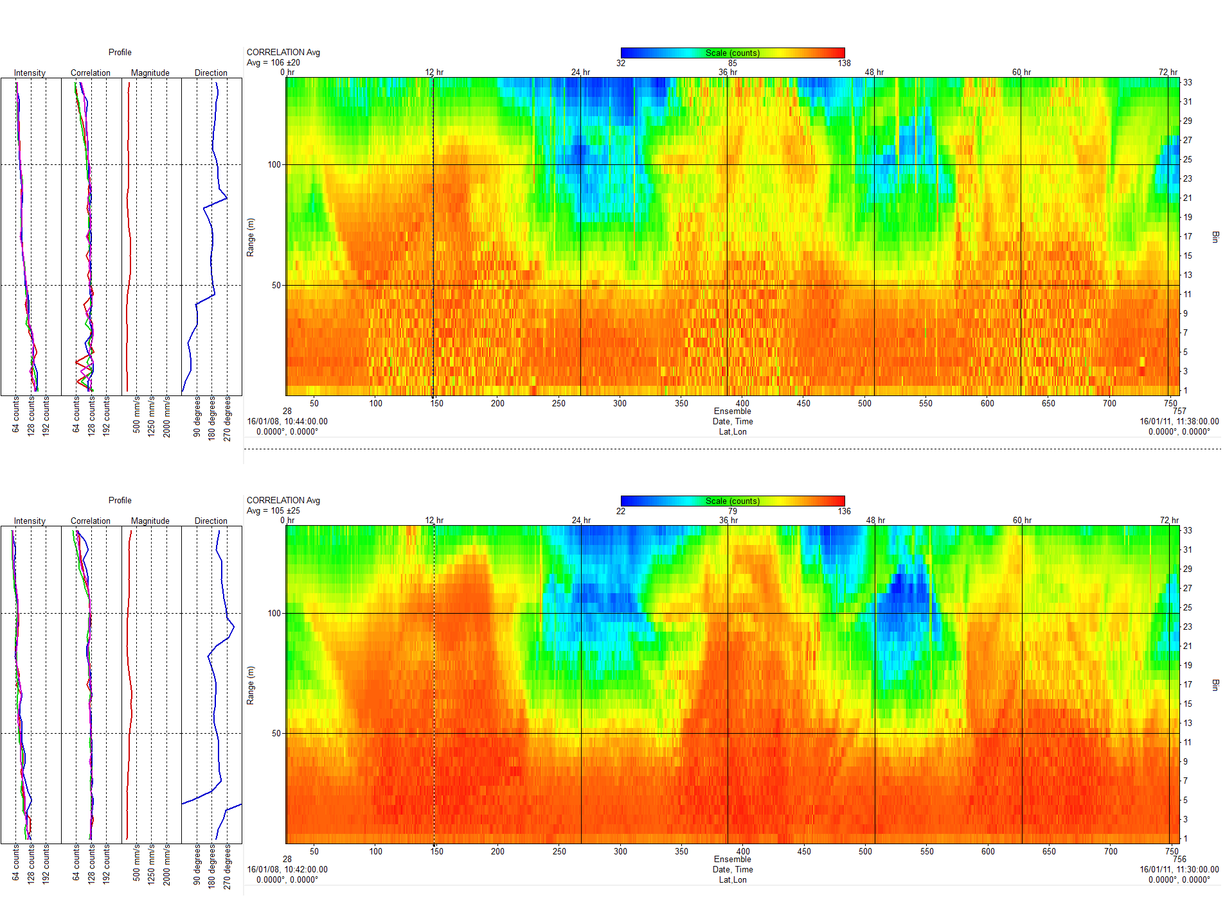
Rowe Technologies, Inc.
Deep Water Correlation
Correlation
SeaWATCH 300
Correlation of each system is nearly identical.
The Sentinel 300 has regions where the ping return de-correlated due to lower signal to noise ratio. Data in this region is marked bad and is not recoverable.
Sentinel 300

Slide 15
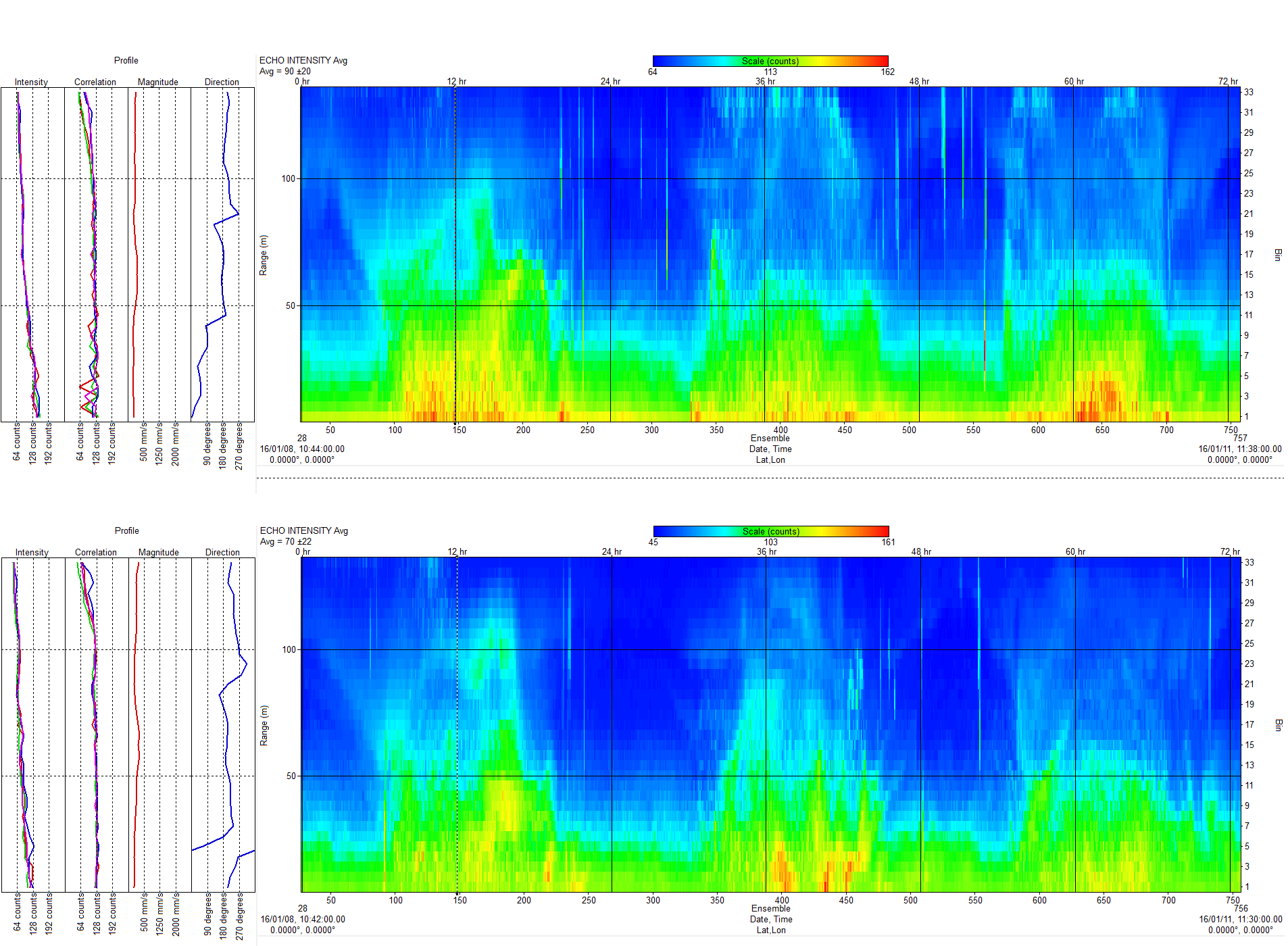
Rowe Technologies, Inc.
Deep Water Echo Intensity
Echo Intensity
SeaWATCH 300
Night
Day
Night
Day
Night
Echo intensity shows the same structure in each system.
Diurnal migration of the backscatter indicates the return is off biological material, typically plankton, that come to the surface during night when lower visibility protects them from predators.
Long cycle interference terms are seen by both systems. Origins of these are unknown.
Sentinel 300
Night
Day
Night
Day
Night

Slide 16
Rowe Technologies, Inc.
Shallow water Stick Vector Plots
Stick vector Plots
Stick Vector Plots show a comparison time series at four individual depths. Data is consistent system to system showing that both systems are making the identical measurements in direction and magnitude. Tidal action is demonstrated by both data sets.

Slide 17
Rowe Technologies, Inc.
Shallow Water Data: 3 meters
Overlaid Speed and direction time series plots show a direct comparison at an individual depth. In these plots it can be observed that the systems are very close in the measurements to be considered brother and sister data points. Data is consistent system to system, and depth to depth. in direction and magnitude. Tidal action is demonstrated by both data sets.
Time series of speed and direction.
Scatter plot of speed and direction.

Slide 18
Rowe Technologies, Inc.
Shallow Water Data: 5 meters
Time series of speed and direction.
Scatter plot of speed and direction.

Slide 19
Rowe Technologies, Inc.
Shallow Water Data: 10 meters
Time series of speed and direction.
Scatter plot of speed and direction.

Slide 20
Rowe Technologies, Inc.
Shallow Water data: 14 meters
Time series of speed and direction.
Scatter plot of speed and direction.

Slide 21
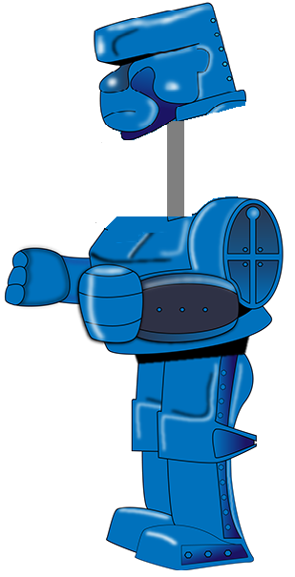
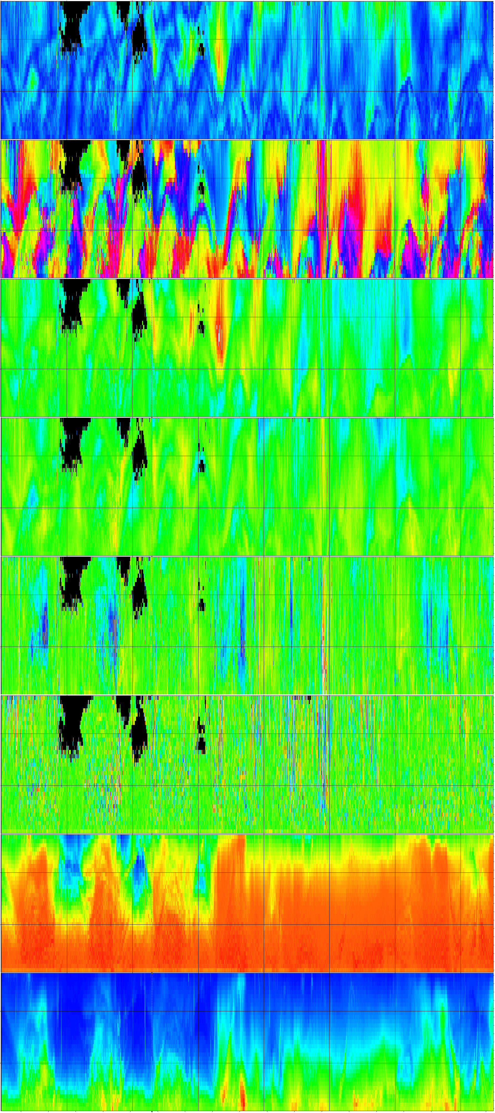
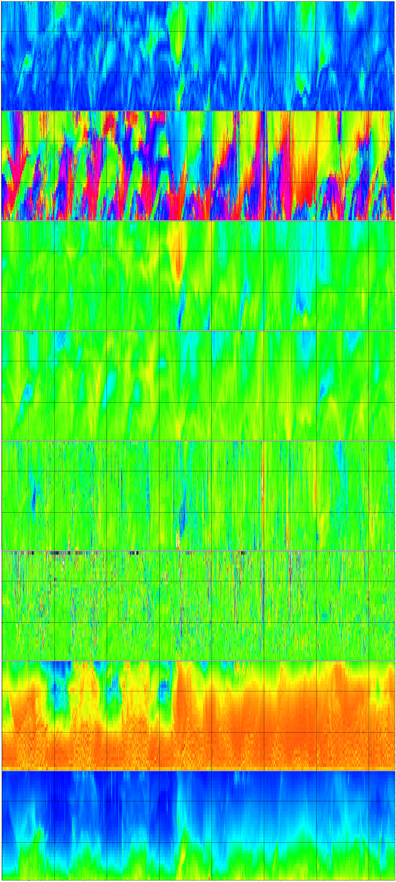
Rowe Technologies, Inc.
Part I Conclusions
Teledyne Sentinel 300
RoweTech SeaWATCH 300
300 kHz, 3” transducer
Conclusions:
Magnitude
Direction
The data analysis shows that the RoweTech SeaWATCH 300 and the Teledyne Sentinel 300 both make the same measurement under identical conditions in deep and shallow water. The RoweTech system shows an overall higher signal to noise return than the Sentinel. This contributes to increased range in normal conditions, or better sensitivity in regions or times when there is less backscatter.
Velocity East
Velocity North
Vertical Velocity
Error Velocity
Correlation
Echo Intensity

Slide 22
Rowe Technologies, Inc.
Part II: 300 kHz Long Range SeaWATCH Compared To Standard 300 kHz ADCP’s
Goal
Demonstrate increased range of Rowe Tech long range 300 kHz SeaWATCH compared to a standard 300 kHz ADCP in deep water
Systems
SeaWATCH 300
Sentinel 300
SeaWATCH 300 5”

Slide 23
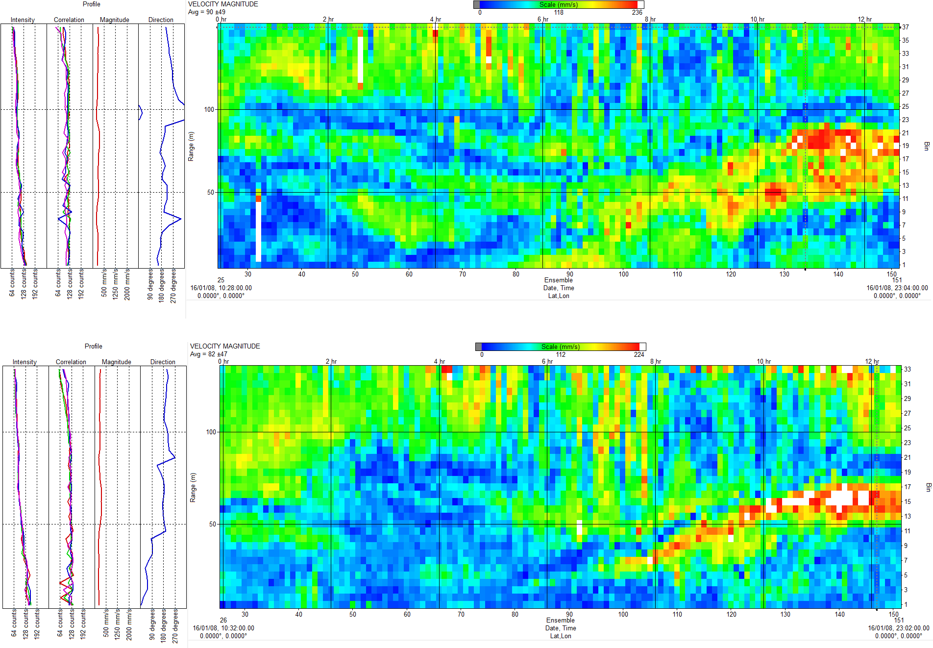
Rowe Technologies, Inc.
Data Comparison: 300-5” To 300-3”; Magnitude
SeaWATCH Long Range 300 kHz
Magnitude
SeaWATCH 300

Slide 24
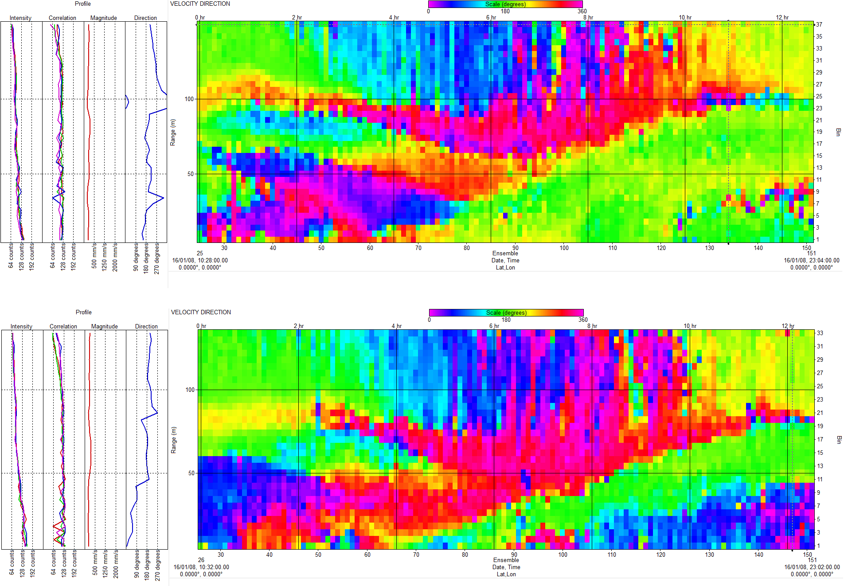
Rowe Technologies, Inc.
Data Comparison: 300-5” To 300-3”; Direction
SeaWATCH Long Range 300 kHz
Direction
SeaWATCH 300

Slide 25
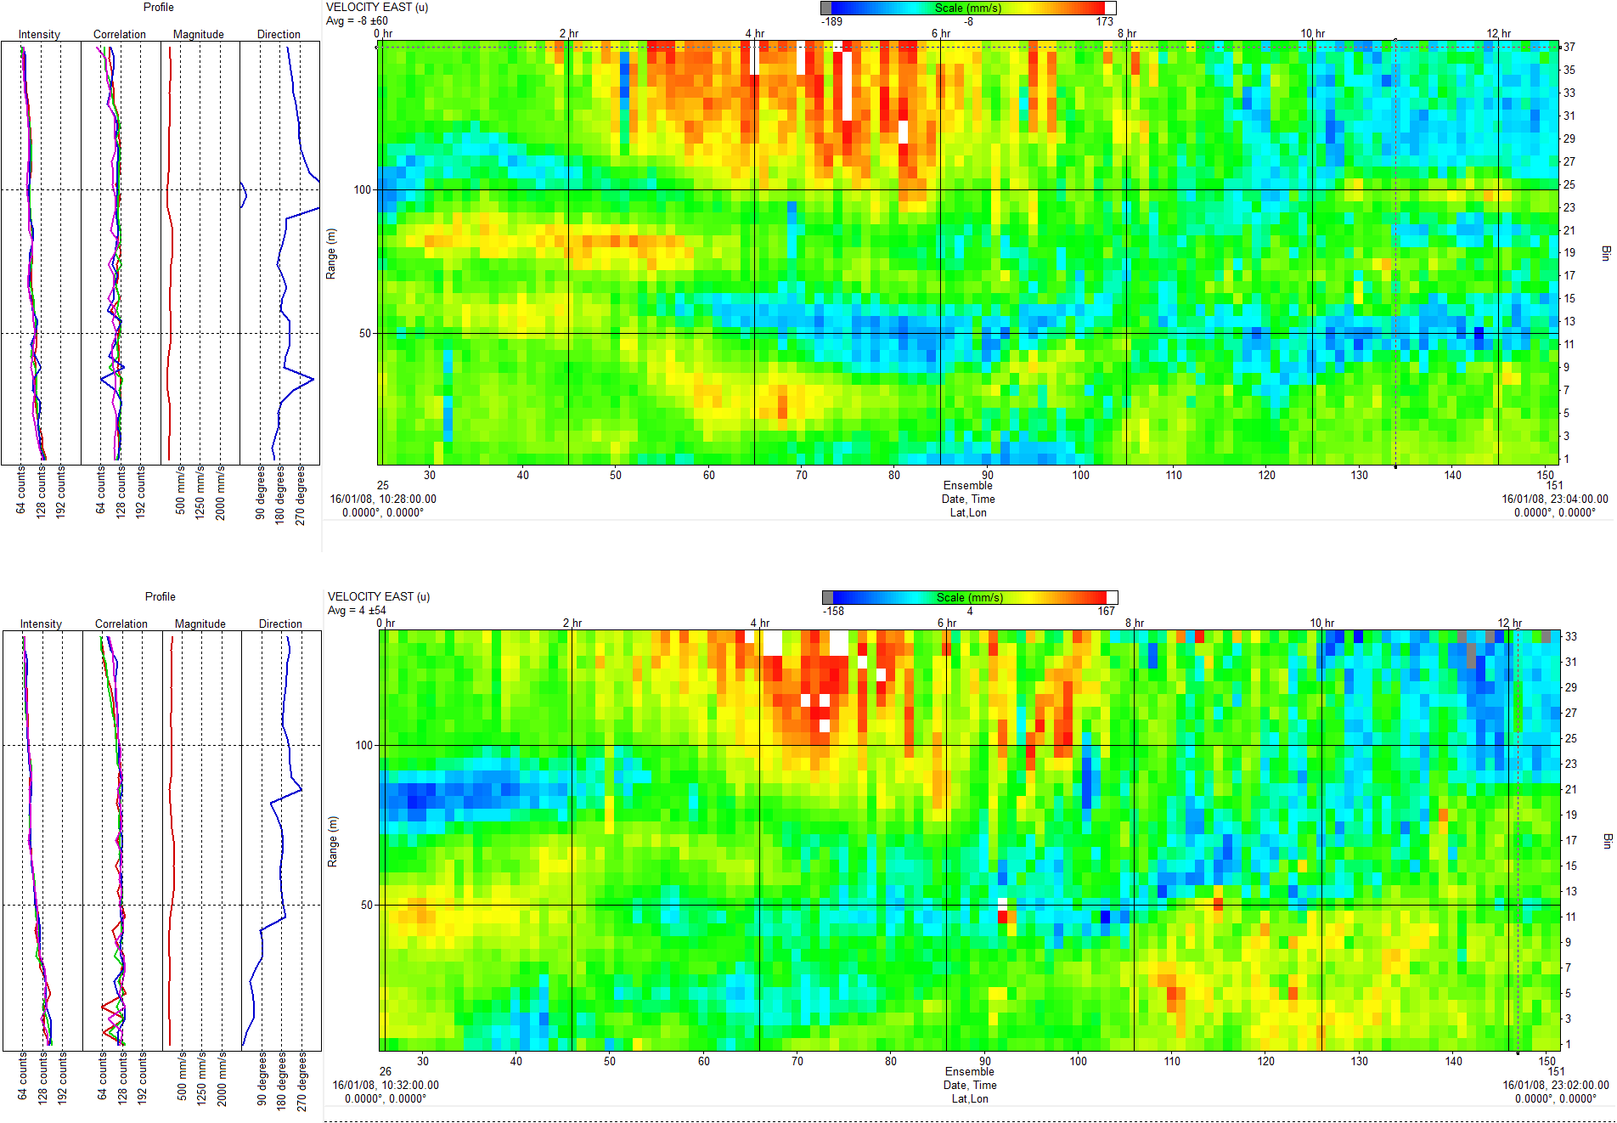
Rowe Technologies, Inc.
Data Comparison: 300-5” To 300-3”; East Velocity
SeaWATCH Long Range 300 kHz
East Velocity
SeaWATCH 300

Slide 26
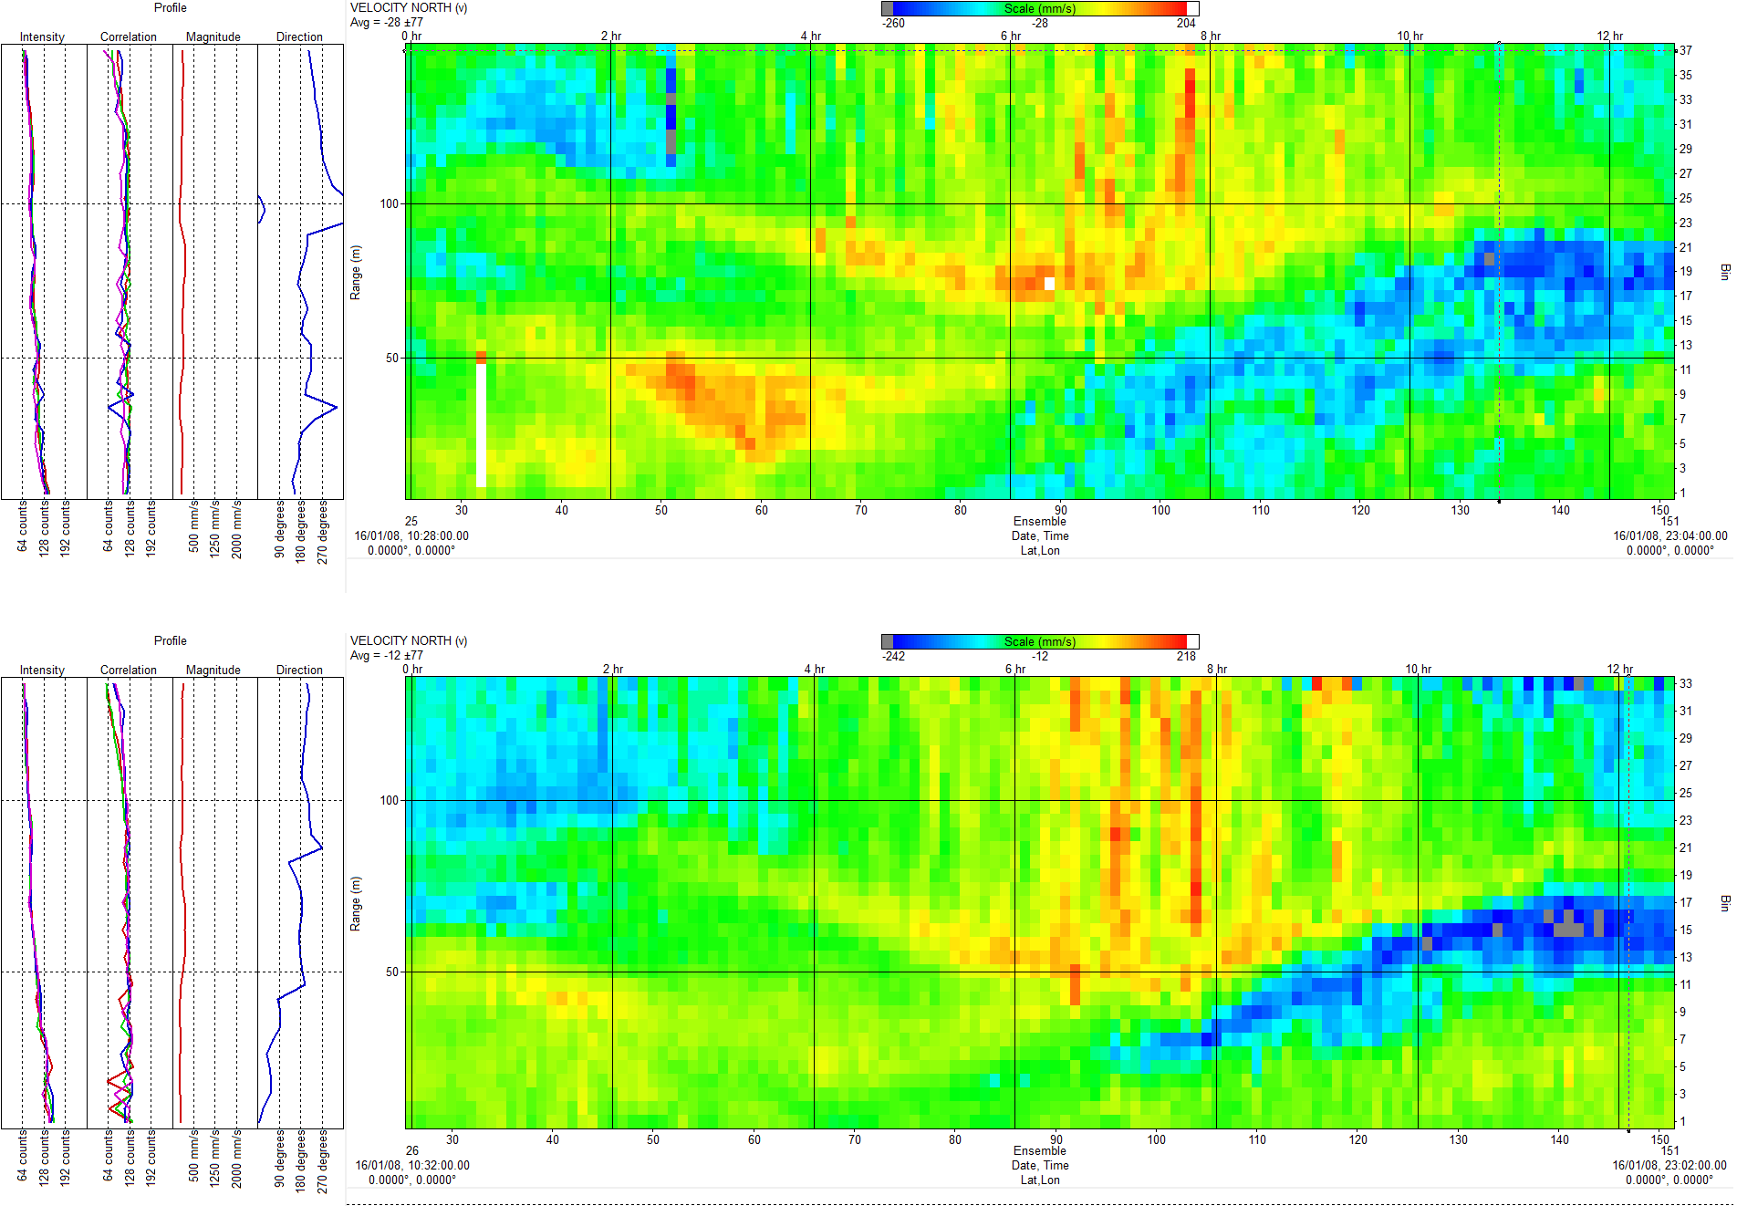
Rowe Technologies, Inc.
Data Comparison: 300-5” to 300-3”; North Velocity
SeaWATCH Long Range 300 kHz
North Velocity
SeaWATCH 300

Slide 27
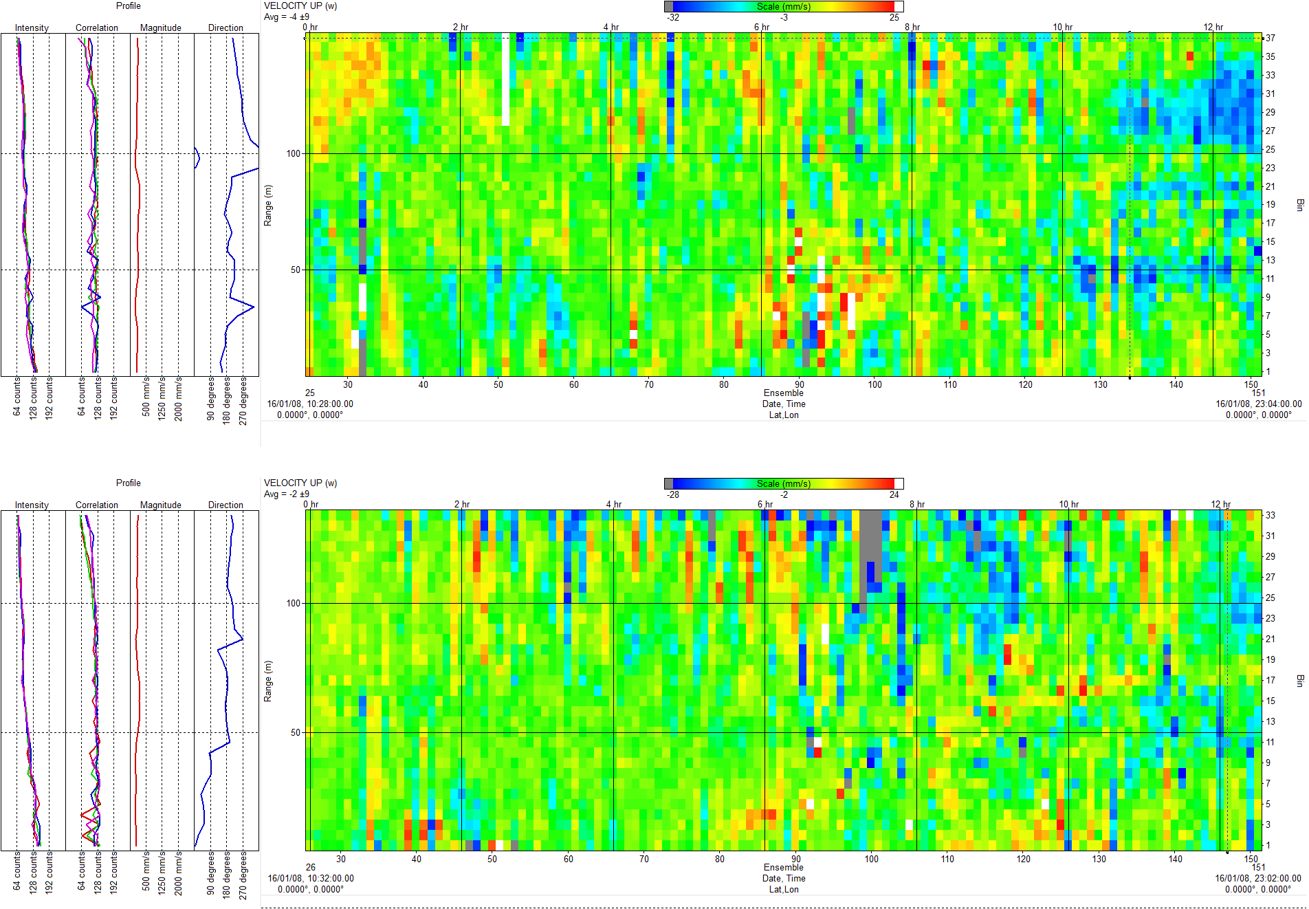
Rowe Technologies, Inc.
Data Comparison: 300 5” to 300 3”;
SeaWATCH Long Range 300 kHz
Vertical Velocity
SeaWATCH 300

Slide 28
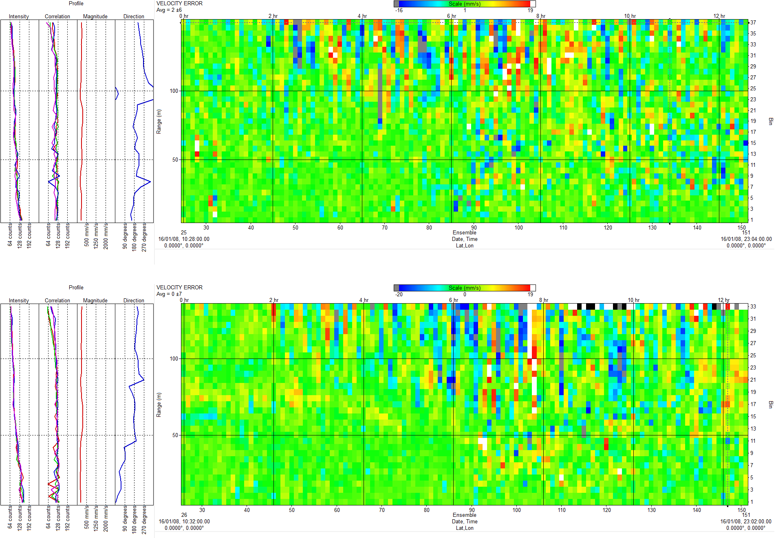
Rowe Technologies, Inc.
Data Comparison: 300-5” to 300-3”; Error Velocity
SeaWATCH Long Range 300 kHz
Error Velocity
SeaWATCH 300

Slide 29
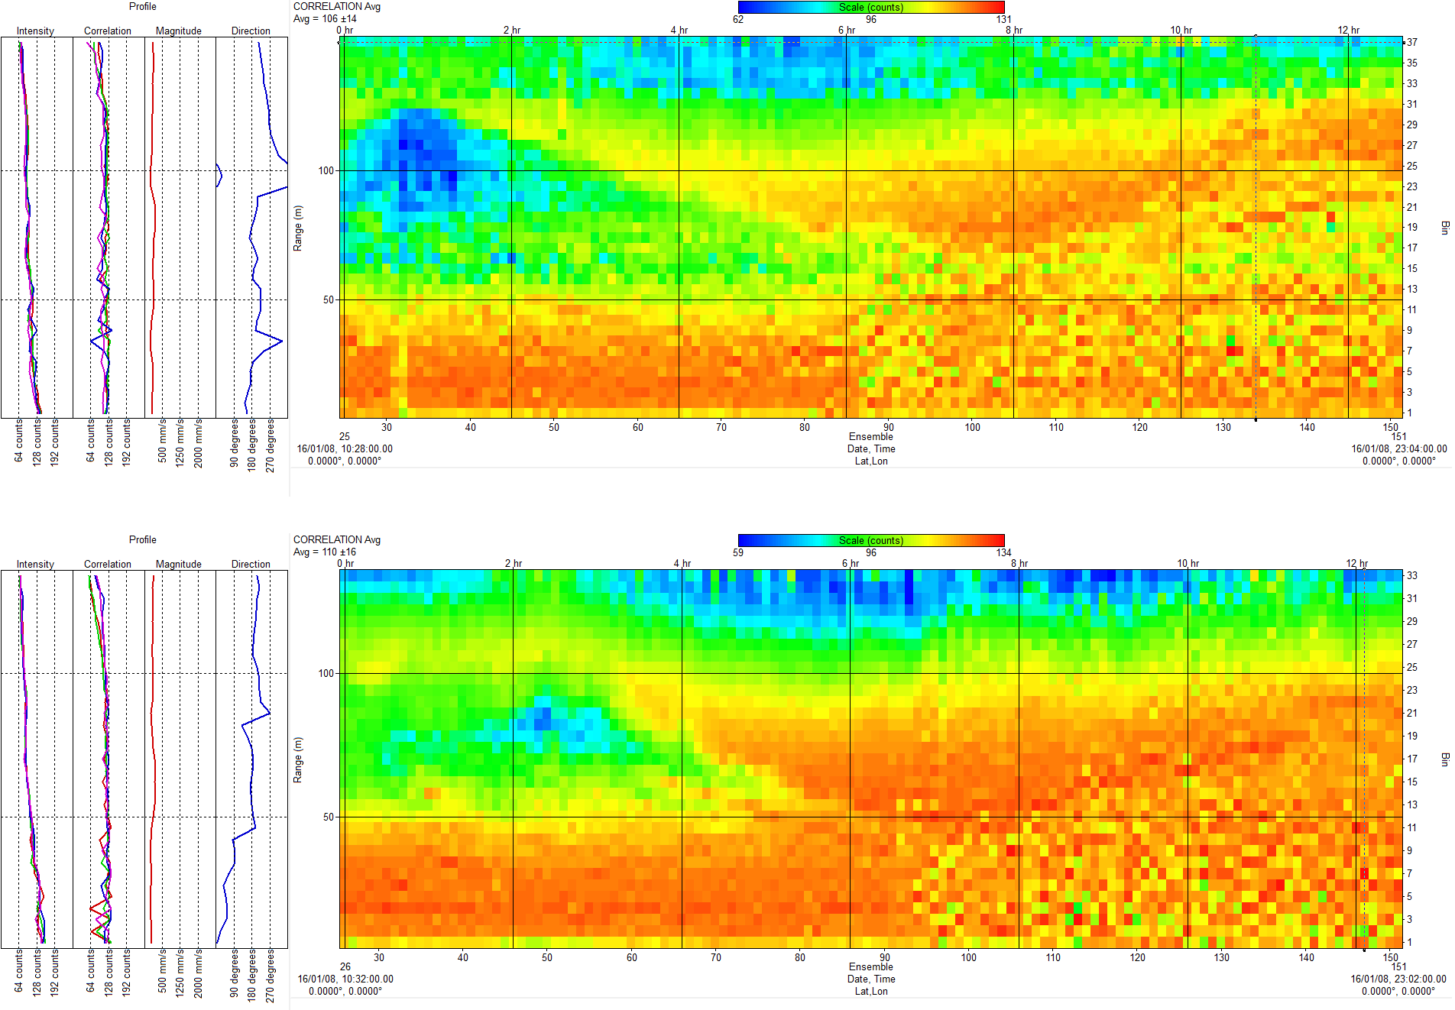
Rowe Technologies, Inc.
Data Comparison: 300-5” to 300-3”; Correlation
SeaWATCH Long Range 300 kHz
Correlation
SeaWATCH 300

Slide 30
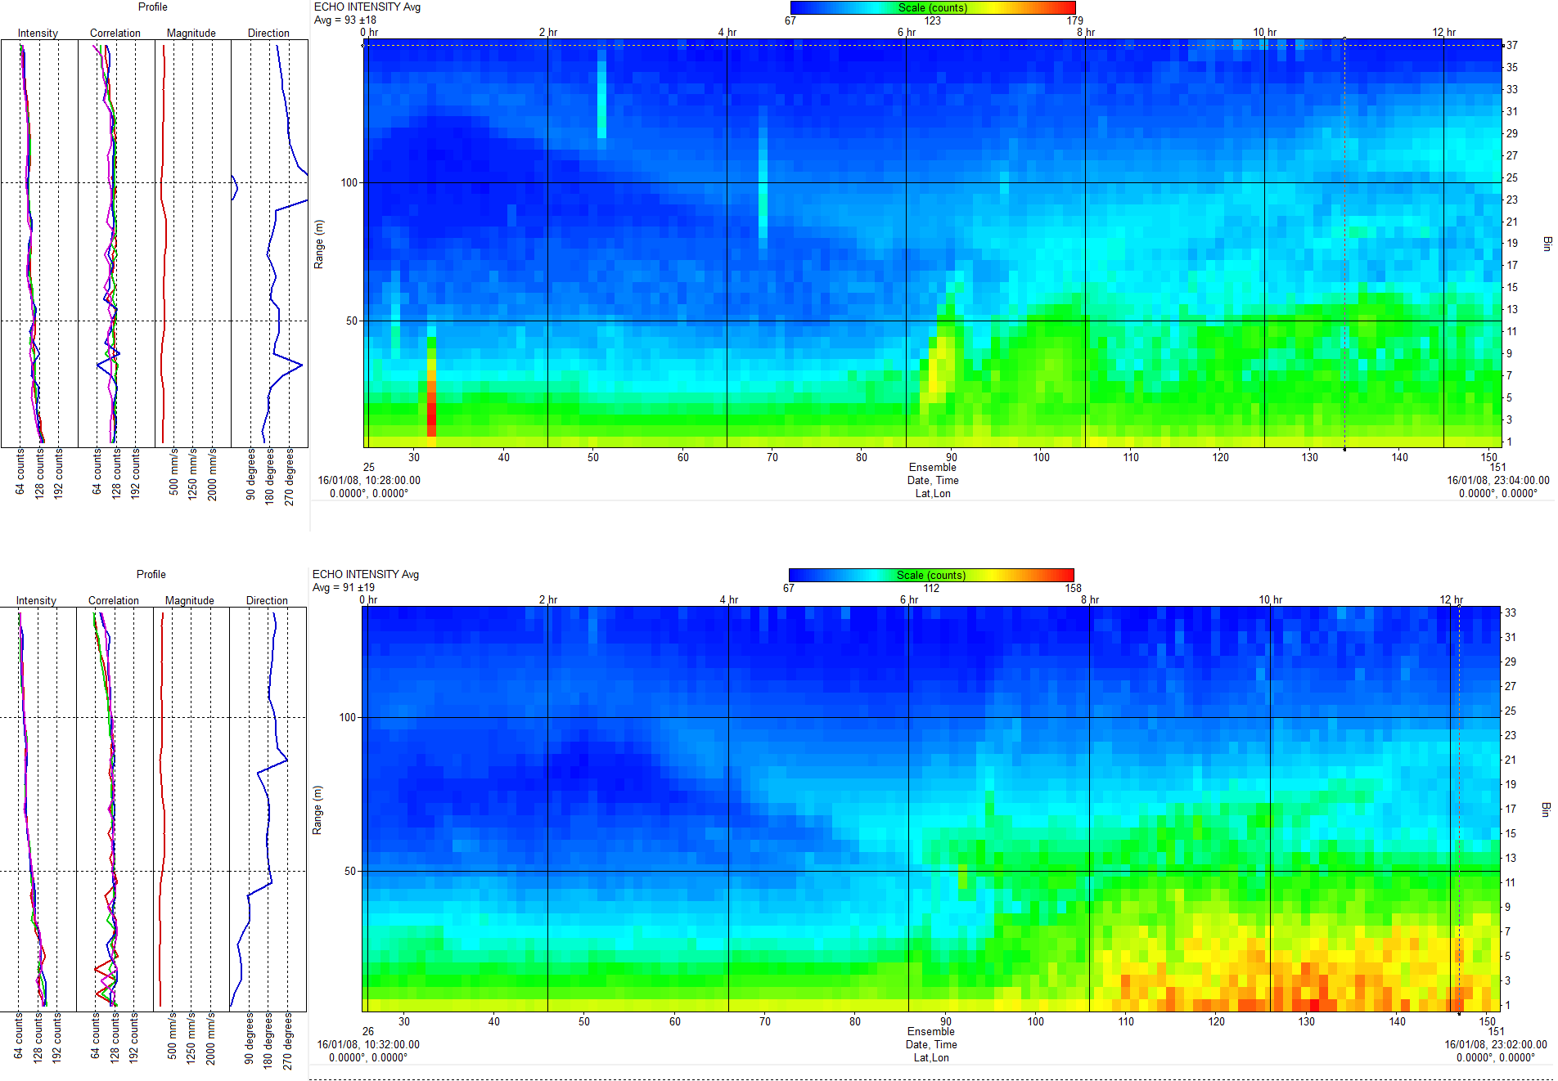
Rowe Technologies, Inc.
Data Comparison: 300-5” to 300-3”; Echo Intensity
SeaWATCH Long Range 300 kHz
Echo Intensity
SeaWATCH 300

Slide 31
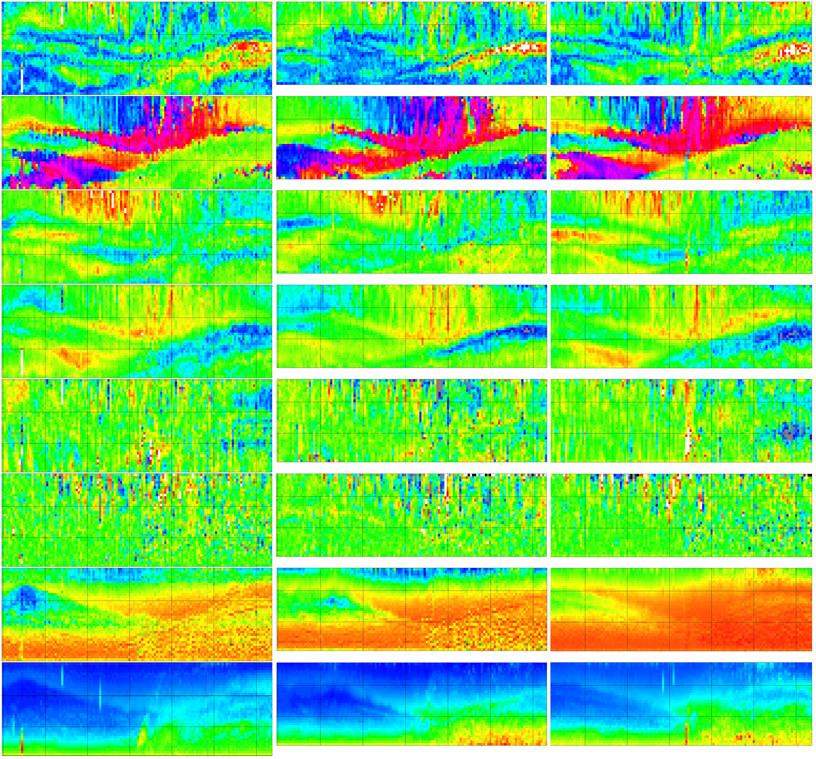
Rowe Technologies, Inc.
Data Comparison: SeaWATCH 300-5” to Standard 3” ADCP’s
Long Range SeaWATCH 300
SeaWATCH 300
Sentinel 300
Magnitude
Direction
Velocity East
Velocity North
Vertical Velocity
Error Velocity
Correlation
Echo Intensity

Slide 32
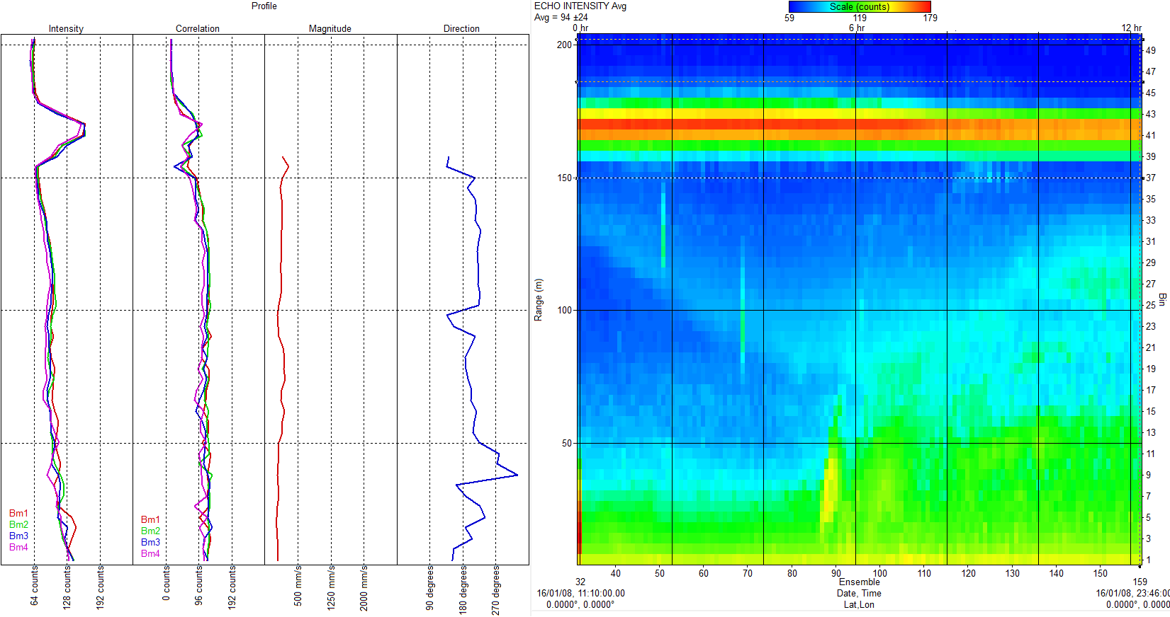
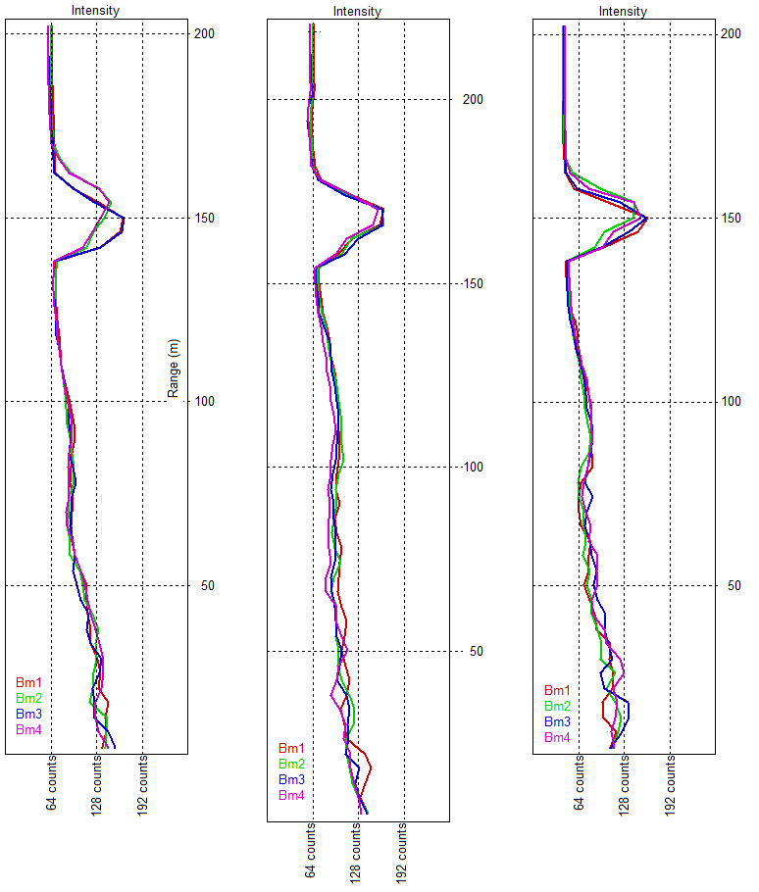
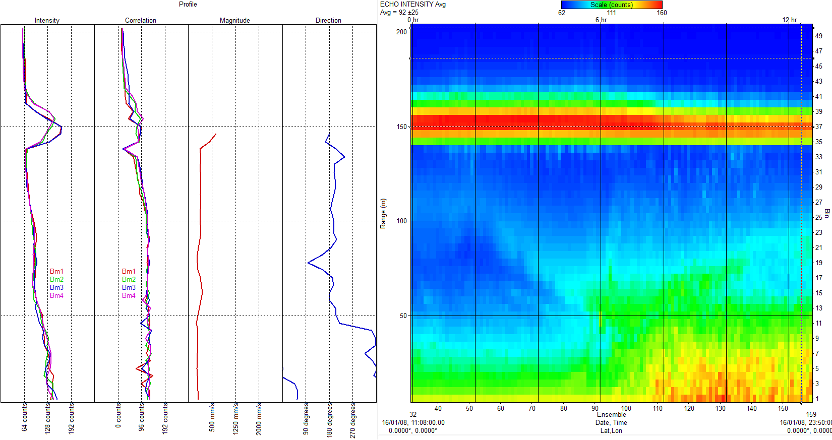
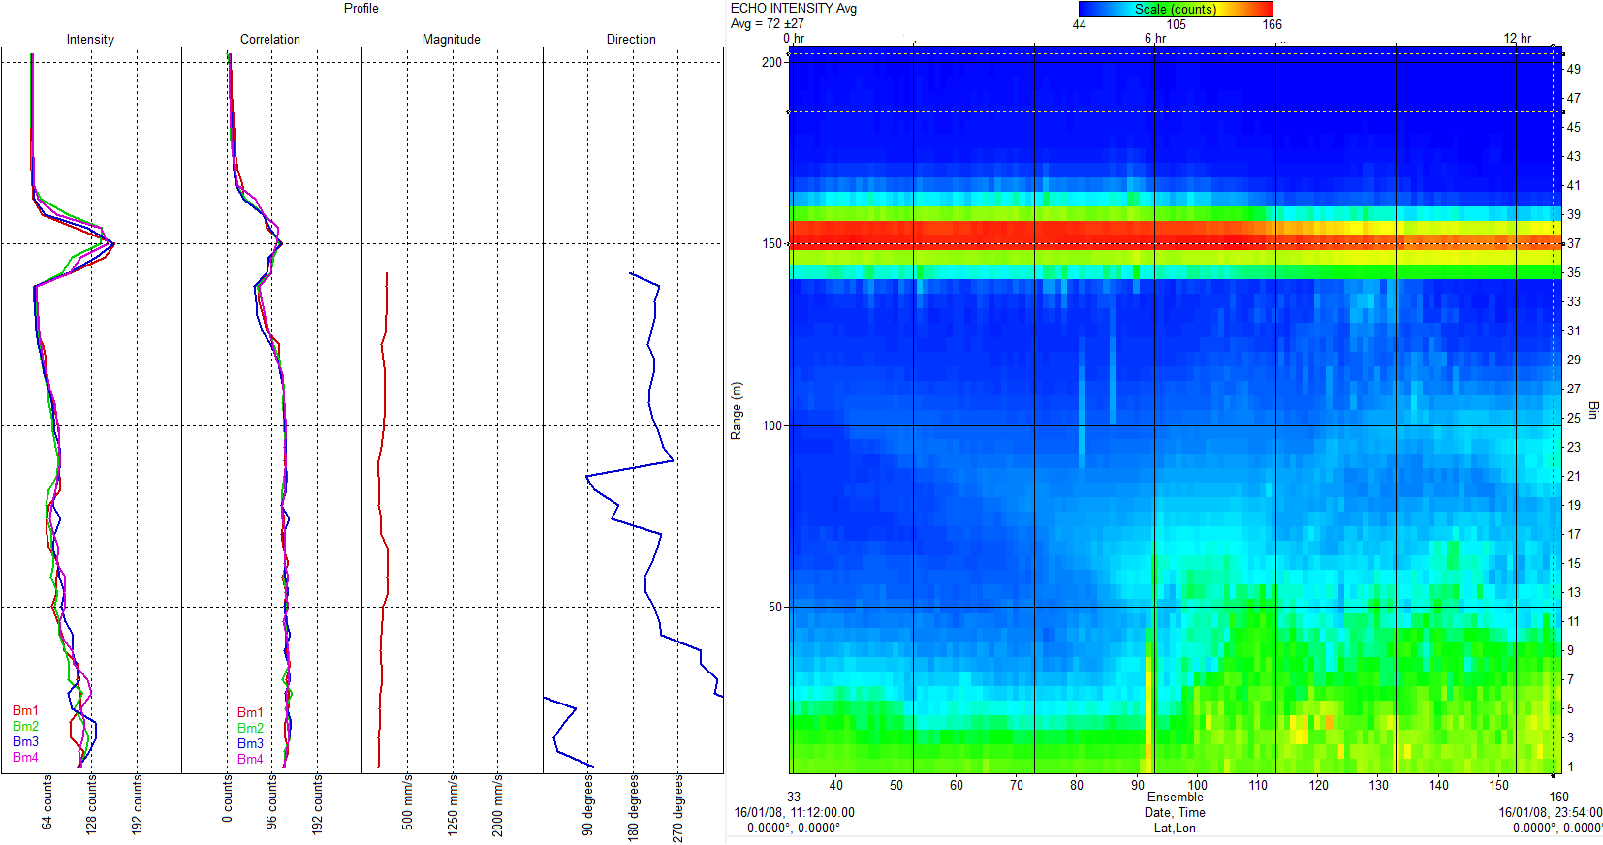
Rowe Technologies, Inc.
Data Comparison: 300-5” to 300-3”; Echo Intensity
SeaWATCH
Long Range 300
300 kHz, 5” and 3” Xducer Conclusions:
SeaWATCH
Long Range 300
The data analysis shows that the SeaWATCH 300 long range ADCP gives superior range to the standard versions. This system was moored at 175 meters and we would expect range in Broadband mode to exceed 200 meters and in narrowband mode to exceed 230 meters when deployed in similar conditions to this test. Both versions can make the same measurement in deep and shallow water. The RoweTech systems show an overall higher signal to noise return than the Sentinel. This contributes to increased range in normal conditions, or better sensitivity in regions or times when there is less backscatter.
SeaWATCH 300
Sentinel 300
SeaWATCH 300
Sentinel 300

